Slide 1
Predicting Housing Prices
Team Training Day:
Jose Gonzalez, John Sipala, Elliot Frost

Slide 2
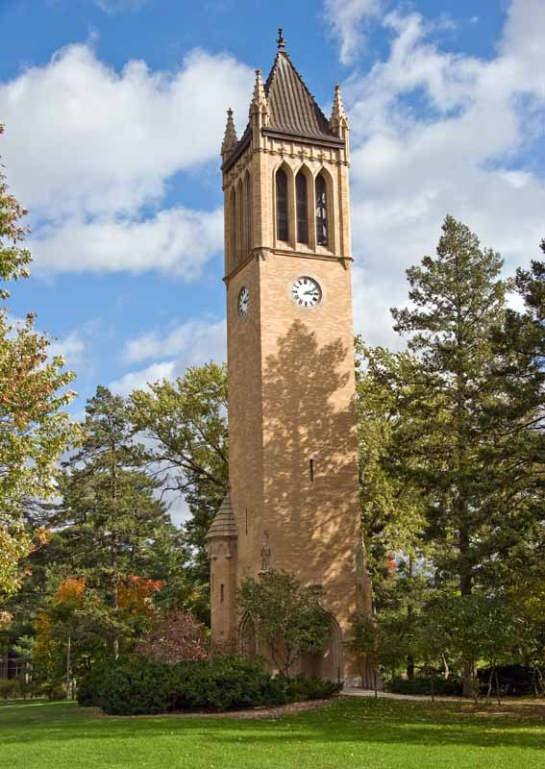
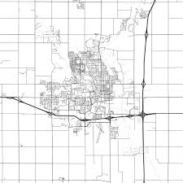
Project Background
Looking to predict housing prices in Ames Iowa.

Slide 3
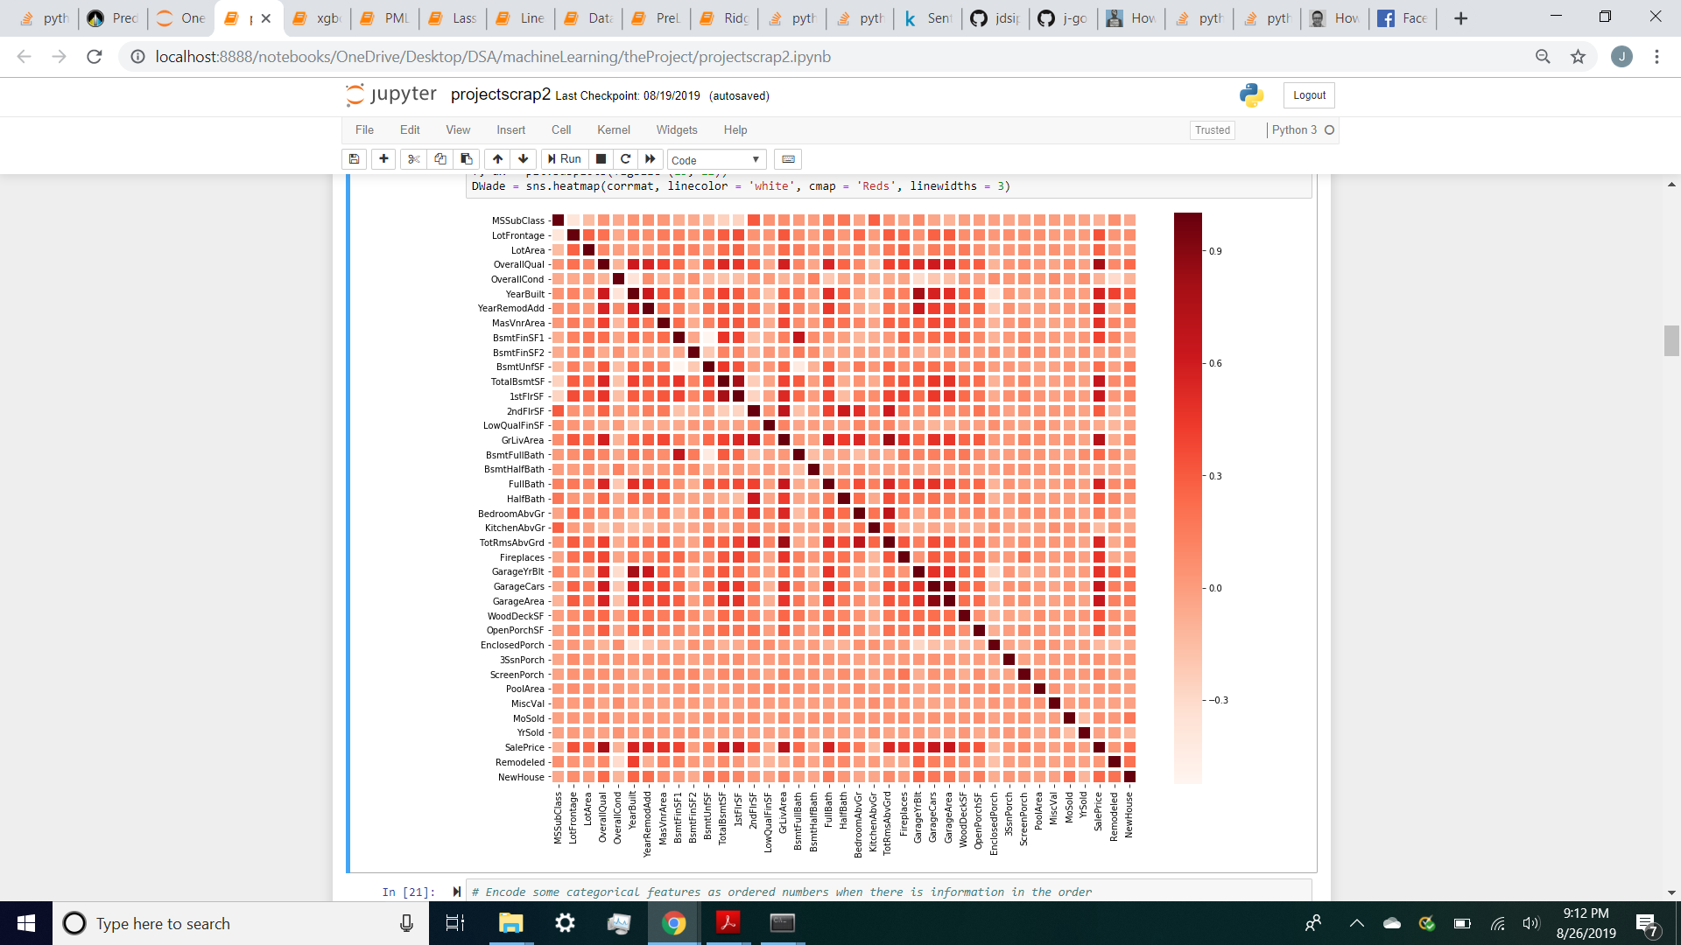

Slide 4
Missingness and Imputation
Many of the columns contained “NA”
Replaced with 0 or None depending on the column
Some 0’s were replaced with mean/ median
(dropped "Id","Street","PoolQC","Utilities","MiscFeature","MiscVal", "Alley")
Features were dropped due being unique to every tuple or had very few instances (e.g. less than 10)
Many non-numerical categories were dummified or given ordinal values

Slide 5
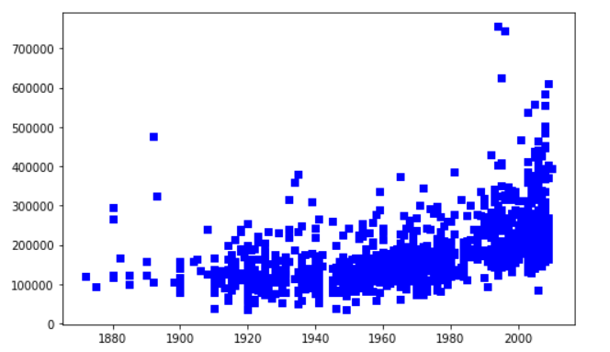
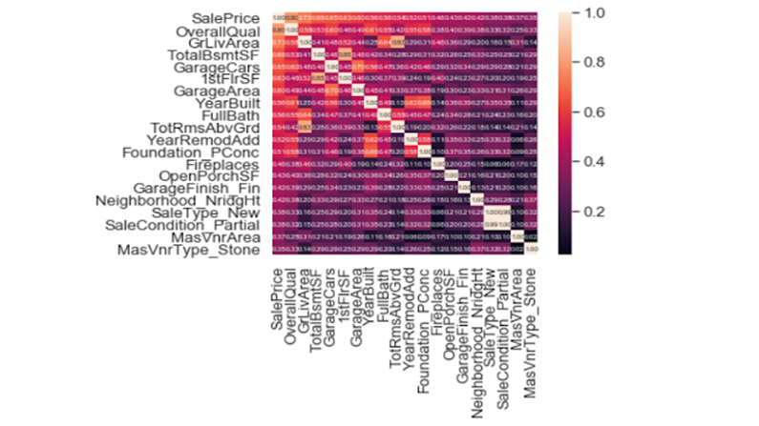
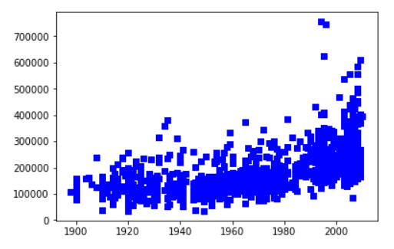
Handling Outliers
Focus on features correlated to sale price

Slide 6
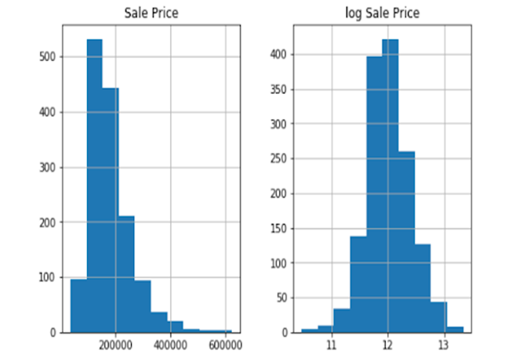
Handling Skewness
Many features were right skewed
Log transform

Slide 7
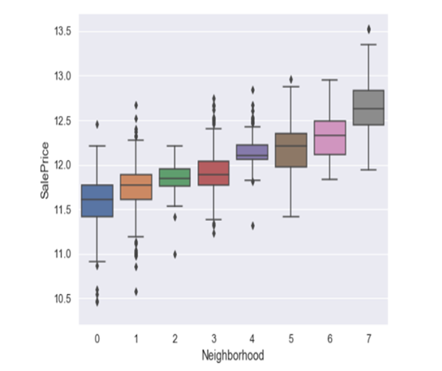
Feature Engineering
Total Baths
Total SF
Median Price By Year
Remodeled (1 or 0)
New House
Redundant columns were dropped
Neighborhood had 0.74 correlation, third strongest of all features

Slide 8
Model Scores
Used GridSearchCV for hyperparameter tuning
Ridge: R^2 = .9082 RMSE = 0.1109
Regular linear regression: R^2 = .9001, RMSE = 0.1308
Lasso: R^2 = 0.9124, RMSE = 0.1083
(Lasso selected 54 variables and eliminated 131)

Slide 9
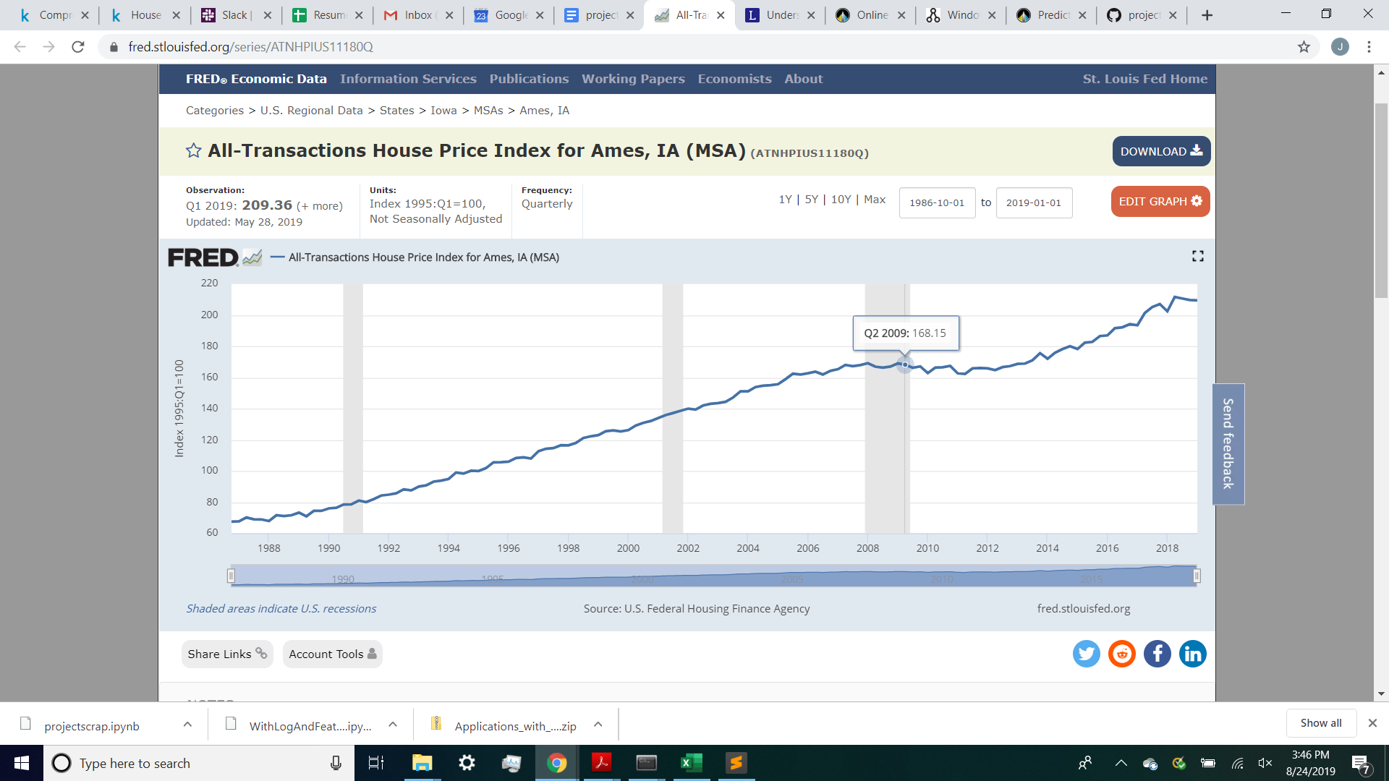
Future Work
Introduce data outside of dataset
We wanted to introduce the Ames, Iowa housing price index
Domain knowledge, roof types, etc.
Seasonality effect of students leaving?

